Slide 1
Overview of
Database Systems
courtesy of Joe Hellerstein and etc for some slides.
SDCS at SYSU
Yubao Liu
Email: lyb163com@163.com

Slide 2
What is a Database ?
Data (http://oxforddictionaries.com/definition/american_english/data. )
  facts and statistics collected together for reference or analysis.
A Database: Data + Base
  A very large, structured collection of data.
  Models some real-world “enterprise”, such as a university
    Entities
      e.g., students, courses
    Relationships
      e.g., Zhang San is taking the Database System course.

Slide 3
What is a Database Management System?
A Database Management System (DBMS) is:
  A software system designed to store, manage, and facilitate query to databases.
Popular DBMS
  Oracle
  IBM DB2
  Microsoft SQL Server
Database System = Databases + DBMS

Slide 4
Typical Applications Supported by Database Systems
Online Transaction Processing (OLTP)
  Recording sales data in supermarkets
  Booking flight tickets
  Electronic banking
Online analytical processing (OLAP) and Data Warehousing
  Business reporting for sales data
  Customer Relationship Management (CRM)

Slide 5
Is the WWW a DBMS?
The Web = Surface Web + Deep Web
Surface Web: simply the HTML pages
  Accessed by “search”:
    Pose keywords in search box.
Deep Web: content hidden behind HTML forms
  Accessed by “query”
    Fill in query forms.

Slide 6

“Search” as “Simple Search”

Slide 7
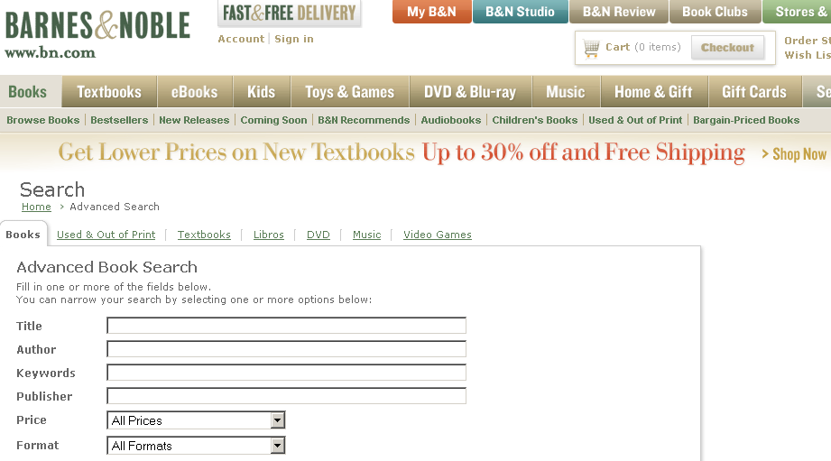
“Query” as “Advanced Search”

Slide 8
“Search” vs. “Query”
Search is structure-free.
  The keywords “database systems” can appear in anyplace in a HTML pages.
Query is structure-aware.
  Say, we restruct that the keywords “database systems” can only appear in the “TITLE” field.
  i.e., we assume there is an underlying STRUCTURE (of a book).

Slide 9
What is a “STUCTURE”?
Referring to the C programming language
  struct BOOK {
  char TITLE [256];
  char AUTHOR [256];
  float PRICE;
  int YEAR;
  }
In this course, we study database management systems that focus on processing structured data.

Slide 10
Files vs. DBMS
We can store data in OS files.
  E.g., Google has its own distributed file system called Google File System (GFS).
What are the advantages of DBMS?
  Good data modeling
    Data Independence
    Data Integrity and Security
  Simple and efficient ad-hoc queries
    Reduced application development time
  Concurrency control
  Crash recovery

Slide 11
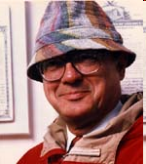
A Historical Perspective (1)
Integrated Data Store (IDS), by Charles Bachman, early 1960s.
  Network data model
  Turing Award Speech, “The Programmer as Navigator”, 1973.
Information Management System (IMS), by IBM, late 1960s.
  Hierarchical data model

Slide 12
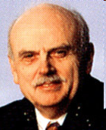
A Historical Perspective (2)
Relational Data Model, by Edgar Codd, 1970.
  Codd, E.F. (1970). "A Relational Model of Data for Large Shared Data Banks". Communications of the ACM 13 (6): 377–387.
  Turing Award, 1981.
System R, by IBM, started in 1974
  Structured Query Language (SQL)
INGRES, by Berkeley, started in 1974
  POSTGRES, Mariposa, C-Store

Slide 13
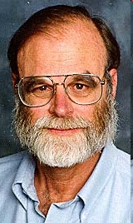
A Historical Perspective (3)
Database Transaction Processing, mainly by Jim Gray.
  J Gray, A Reuter. Transaction processing: concepts and techniques. 1993.
  Turing Award, 1998.
Object-Relational DBMS, 1990s.
  Stonebraker, Michael with Moore, Dorothy. Object-Relational DBMSs: The Next Great Wave. 1996.
  Postgres (UC Berkeley), PostgreSQL.
  IBM's DB2, Oracle database, and Microsoft SQL Server

Slide 14

A Historical Perspective (4)
Michael Stonebraker wins $1 million Turing Award.
  MIT's Computer Science and Artificial Intelligence Laboratory researcher invented core database concepts, turned many into companies (http://news.mit.edu/2015/michael-stonebraker-wins-turing-award-0325).
  Turing Award, 2014.
Influential systems, ingres and postgres.
Creating and leading nine separate companies, including VoltDB, Tamr, Paradigm4, and Vertica (which was bought by Hewlett-Packard in 2011 for $340 million).

Slide 15
From OLTP to OLAP and Data Warehousing
OLAP (On-Line Analytical Processing, Codd, 1993)
  Flexible Reporting for Business Intelligence
Characteristics of OLAP applications :
  Transactions that involve large numbers of records
  Frequent Ad-hoc queries and Infrequent updates
  A few decision making users
  Fast response times
Data warehouses are designed to facilitate reporting and analysis.
  Read-Mostly DBMS: C-Store, MonetDB

Slide 16
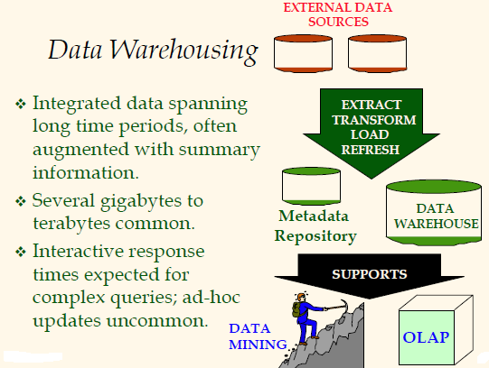

Slide 17
Data Mining (DM)
DM is the exploration and analysis of large quantities of data in order to discover valid, novel, potentially useful, and ultimately understandable patterns in data.
Association Rules
  60% of all customers who purchase diapers also buy beer.
Classification: Email spam
Clustering
  Cluster Sina Weibo users by similar interests
Web Page Ranking: Google’s PageRank

Slide 18
Big Data (1)
By Oxford Dictionaries: data sets that are too large and complex to manipulate or interrogate with standard methods or tools.
This data comes from everywhere:
  sensors used to gather climate information,
  posts to social media sites,
  digital pictures and videos,
  stock records,
  cell phone GPS signals.

Slide 19
Big Data (2)
By IBM, http://www-01.ibm.com/software/data/bigdata/
Big data spans four dimensions:
  Volume, terabytes (TB), even petabytes of information
    Use 12 TB of Tweets created each day for sentiment analysis
  Velocity, Sometimes 2 minutes is too late
    Check 5 million trade events created each day for potential fraud
  Variety, Big data is any type of data - structured and unstructured data
    Exploit the 80% data growth in images, video and documents to improve customer satisfaction
  Veracity ( the quality of being true)
    1 in 3 business leaders don’t trust the information they use to make decisions

Slide 20
Describing Data: Data Models
A data model is a collection of concepts for describing data.
A schema is a description of a particular collection of data, using a given data model.
The relational data model is the most widely used model today.
  Main concept: relation, basically a table with rows and columns.
  Every relation has a schema, which describes the columns, or fields (their names, types, constraints, etc.).

Slide 21
Schema in Relation Data Model
A relation schema is a TEMPLATE of the corresponding relation.
Definition of the Students Schema
Students (sid: string, name: string, login: string, age: integer, gpa: real)
Table 1. An Instance of the Students Relation
sid | name | login | age | gpa
53666 | Jones | jones@cs | 18 | 3.4
53688 | Smith | smith@ee | 18 | 3.2
53650 | Smith | smith@math | 19 | 3.8

Slide 22
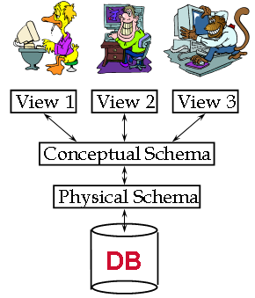
Levels of Abstraction in a DBMS
Many views describe how users see the data.
  Personalized access of data.
Conceptual schema defines logical structure
  i.e., what relations to store.
Physical schema specifies physical structure.
  How the “logical” relations are physically stored on external storage such as disk.
courtesy of Joe Hellerstein

Slide 23
Example: University Database
Conceptual schema:
  Students(sid: string, name: string, login: string, age: integer, gpa: real)
  Courses(cid: string, cname: string, credits: integer)
  Enrolled(sid: string, cid: string, grade: string)
Physical schema:
  Relations stored as unordered files.
  Index on first column of Students.
External Schema (View):
  Course_info(cid: string, enrollment: integer)

Slide 24
Data Independence
Applications insulated from how data is structured and stored.
Logical data independence: Protection from changes in logical structure of data.
Physical data independence: Protection from changes in physicalstructure of data.
*One of the most important benefits of using a DBMS!

Slide 25
Queries in a Relational DBMS
Specified in a Non-Procedural way
  Users only specify what data they need;
  A DBMS takes care to evaluate queries as efficiently as possible.
a Non-Procedural Query Language:
  SQL: Structured Query Language
  Basic form of a SQL query:
SELECT target-list
FROM relation-list
WHERE qualification

Slide 26
A Simple SQL Example
At an airport, a gate agent clicks on a form to request the passenger list for a flight.
  SELECT name
  FROM Passenger
  Where flight = 510275
Passenger(pid: string, name: string, flight: integer)

Slide 27
Concurrent execution of user programs
Why?
  Utilize CPU while waiting for disk I/O
    (database programs make heavy use of disk)
  Avoid short programs waiting behind long ones
    e.g. ATM withdrawal while bank manager sums balance across all accounts

Slide 28
Concurrent execution
Interleaving actions of different user programs can lead to inconsistency:
  Example:
  Bill transfers $100 from savings to checking
    Savings –= 100; Checking += 100
  Meanwhile, Bill’s wife requests account info.
  Bad interleaving:
    Savings –= 100
    Print balances
    Checking += 100
  Printout is missing $100 !

Slide 29
Concurrency Control
DBMS ensures such problems don’t arise.
Users can pretend they are using a single-user system.

Slide 30
Key concept: Transaction
An Transaction is an atomic sequence of database actions (reads / writes)
Each transaction, executed completely, must leave the DB in a consistent state if DB is consistent when the transaction begins.

Slide 31

Example of Transaction

Slide 32
Incomplete Transaction and System Crashes
Incomplete transaction
  Canceled by the transaction or DBMS
  Aborted unexpectedly by system crash
Idea: Keep a log (history) of all actions carried out by the DBMS while executing a set of transactions:
  Before a change is made to the database, the corresponding log entry is forced to a safe location. (WAL protocol; OS support for this is often inadequate.)
  After a crash, the effects of partially executed transactions are undone using the log.

Slide 33
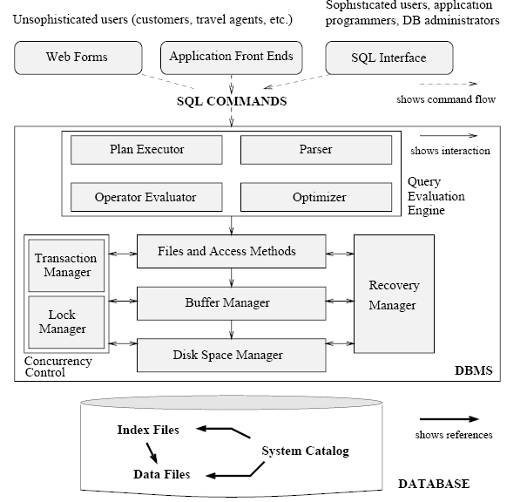
STRUCTURE OF A DBMS

Slide 34
Databases make these folks happy ...
End users and DBMS vendors
DB application programmers
  E.g., smart webmasters
Database administrator (DBA)
  Designs logical /physical schemas
  Handles security and authorization
  Data availability, crash recovery
  Database tuning as needs evolve
  Must understand how a DBMS works!

Slide 35
Summary
DBMS used to maintain, query large datasets.
Benefits include recovery from system crashes, concurrent access, quick application development, data integrity and security.
Levels of abstraction give data independence.
A DBMS typically has a layered architecture.
DBAs hold responsible jobs and are well-paid!
DBMS R&D is one of the broadest, most exciting areas in CS.
We focus on Relational DBMS:
  maintain/query structured data

